Slide 1
Introduction to Data Science
Unit 4 – Hypothesis and Inference

Slide 2
Statistical Hypothesis
A statistical hypothesis is:
A method of statistical inference.
An assumption about a population parameter.
●
This assumption may or may not be true.
For example:
The statement “µ > 11” is a hypothesis about the population
mean µ.
We must perform a Hypothesis Test in order to determine how certain can we be that the Hypothesis is true.

Slide 3
Statistical Hypothesis
●
The best way to determine whether a statistical hypothesis is true would be to examine the entire population.
●
Since that is often impractical, researchers typically examine a random sample from the population.
●
If sample data are not consistent with the statistical hypothesis, the hypothesis is rejected.

Slide 4
Hypothesis Test
Hypothesis tests are statistical procedures that evaluate two mutually exclusive statements about a population.
These two statements are called the null hypothesis and the alternative hypothesis. [ two types of statistical hypotheses]
They are always statements about population attributes, such as the value of a parameter, the difference between corresponding parameters of multiple populations, or the type of distribution that best describes the population.
A hypothesis test uses sample data to determine which statement is best supported by the data.

Slide 5
Types of Statistical Hypotheses
There are two types of statistical hypotheses:
Null hypothesis: The null hypothesis, denoted by H , is usually
●
0
the hypothesis that sample observations result purely from chance(sampling error – random variation). [Accepted Fact or No difference or No effect – It always says the sample is misleading]
●
Alternative hypothesis. The alternative hypothesis, denoted by
H or H , is the hypothesis that sample observations are
1 a
influenced by some non-random cause (investigator's belief).

Slide 6
Guidelines to choose H₀
Null Hypotheis is chosen as something:
●
Which the scientists or statisticians want to disprove or nullify.
Or is an accepted fact.
Lack of a difference : It just says with and without modification the results are the same(no difference). There's no effect of making a change.
It says whatever the sample is saying or depicting is misleading.
●
●
●

Slide 7
Example : Identify H₀ and H_{a}
A coin was flipped 50 times, resulting in 40 Heads and 10 Tails.

Slide 8
Two interpretations of the sample:
Null Hypothesis : says that the effect indicated by the sample is due to Sampling variation and tha the coin is fair and unbaised. (coin is given a benefit of doubt)Hence, null hypothesis might be that half the flips would result in Heads and half, in Tails.
H : P = 0.5
0
Alternative Hypothesis : says that the effect indicated by the sample is real and that the coin is not fair and biased. The alternative hypothesis might be that the number of Heads and Tails would be very different.
H : P ≠ 0.5
a

Slide 9
Example 1 : Identify H₀ and H_{a}
A hypothesis is put forward that children who take vitamin C are less likely to become ill during flu season than those who do not. A hypothesis test is conducted where a sample group of children is given vitamin C for three months while another group is not.

Slide 10
Example 1 : Solution
Null Hypothesis : Taking vitamin C does not produce any effect.
Alternative Hypothesis : Taking Vitamic C produces a difference.
As it turns out, the alternative hypothesis is confirmed.

Slide 11
Example 2 : Identify H₀ and H_{a}
An individual claims that, contrary to what is commonly accepted, he is telekinetic(the production of motion in objects without contact or other physical means.) and can read minds.
●

Slide 12
Example 2 : Solution
Null Hypothesis : He cannot read minds and is not telekinetic.
Alternative Hypothesis : He can read minds and is telekinetic.

Slide 13
Example 3 :Identify H₀ and H_{a}
Accused of a grave crime, a person is placed under arrest and a trial is conducted.
●

Slide 14
Example 3 : Solution
Null Hypothesis : He is innocent, is challenged in court. [ Defendant is given benefit of doubt - To give someone the benefit of the doubt means you assume that he or she is telling the truth until proven otherwise.].
Alternative Hypothesis : He is not innocent and has committed the crime.

Slide 15
Problem 1(a)
In each of the following situations, state the most appropriate null hypothesis regarding the population mean µ.
1) A new type of battery will be installed in heart pacemakers if it can be shown to have a mean lifetime is greater than eight years.

Slide 16
Problem 1(a) : Solution
1) A new type of battery will be installed in heart pacemakers if it can be shown to have a mean lifetime is greater than eight years.
H₀ : µ ≤ 8 H₁ : µ >8

Slide 17
Problem 1(b)
In each of the following situations, state the most appropriate null hypothesis regarding the population mean µ.
2) A new material for manufacturing tires will be used if it can be shown that the mean lifetime of the tires will be more than 60,000 miles.

Slide 18
Problem 1(b) : Solution
2) A new material for manufacturing tires will be used if it can be shown that the mean lifetime of the tires will be more than 60,000 miles.
H₀ : µ ≤ 60,000
H₁ : µ > 60,000

Slide 19
Problem 1(c)
In each of the following situations, state the most appropriate null hypothesis regarding the population mean µ.
3) A quailty control inspector will recalibrate a flowmeter if the mean flow rate differs from 10 mL/s.

Slide 20
Problem 1(c) : Solution
3) A quailty control inspector will recalibrate a flowmeter if the mean flow rate differs from 10 mL/s.
H₀ : µ = 10
H₁ : µ ≠ 10

Slide 21
Real world applications of Hypothesis Testing
Testing whether more men than women suffer from nightmares.
Evaluating the effect of the full moon on behavior.
Checking whether bumper stickers reflect car owner behavior.
Testing the claims of handwriting analysts.

Slide 22
Hypothesis Test
In performing Hypothesis Test, we essentially put the null hypothesis on trial.
We begin by assuming H₀ is true.
●
The random sample provides the evidence.
The Hypothesis test involves measuring the strength of disagreement between the sample and H₀ .
Two methods :
●
●
●
Traditional Method : Rejection region approach
P-value approach (Used in book – Commonly used)

Slide 23
Note
In any hypothesis test, we are calculating conditional probabilities based on the assumption that the null hypothesis is true.

Slide 24
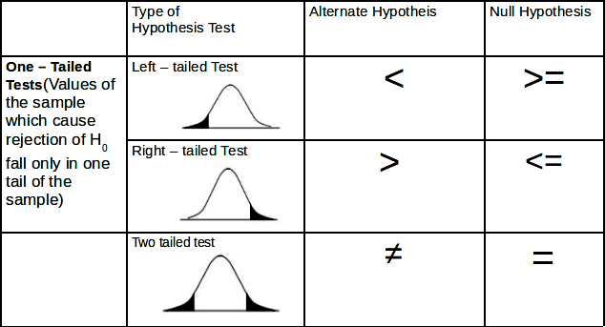
Type of Hypothesis Tests

Slide 25
test-statistic
A test statistic is a standardized value that is calculated from sample data during a hypothesis test.
Used to determine whether to reject the null hypothesis.
The test statistic used to assess the strength of evidence against H₀ .
Its observed value changes randomly from one random sample to a different sample.
●
●
●
●

Slide 26
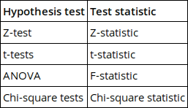
Different Hypothesis Tests
Different hypothesis tests use different test statistics based on the probability model assumed in the null hypothesis. Common tests and their test statistics include:
●

Slide 27
Steps in Performing a Hypothesis Test
Define H₀ and H₁.
Assume H₀ is true
Compute test statistic.
Compute P-value based on chosen α
(significance level).
State a conclusion.

Slide 28
Unit Contents
Z – tests for:
Population mean µ of Large Samples. (Section 6.1, 6.2)
Difference between Two Population Means of Large Samples. (Section 6.5)
Population proportion of Large Samples. (Section 6.3)
Difference between Two Population proportions of Large Samples. (Section 6.6)
Paired Data. (Section 6.8)
t – tests for:
1) Paired Data. (Section 6.8)
Fixed level testing (Section 6.12) Power of a Test (Section 6.13)

Slide 29
Note
 | Population SD known | Population SD unknown
n < 30 (small sample and appears to come from a normal population) | Use Z table | Use t table
n >= 30 (large sample) | Use Z table | Use Z or t table

Slide 30
A test that uses z-score as a test statistic is called z-test.

Slide 31
Z – tests for Population mean µ of Large Samples (Section 6.1)

Slide 32
Example
An automobile engine emits oxides of Nitrogen(NO ) at a mean
x
rate of 100 mg/s.
●
A modification to the engine design has been proposed that may
reduce NO emissions.
x
The new design will be put in production if it can be demostrated that the its mean emission rate is less than 100mg/s.
A sample of 50 modified engines are built and tested. The
●
●
sample mean NO emission is 92 mg/s and the sample SD is 21
mg/s.
Define H and H .
0 1
x

Slide 33
Null Hypothesis
Since the planned action(Putting modified engine design in production) is based on the criteria that the emission rates shold be lower than 100.
Null Hypothesis can be set as:
Something that the manufacturers would like to disprove.
Something that says the sample is misleading and might have come from the populaiton that has mean greater than 100. Hence,
H₀ : µ ≥ 100
●

Slide 34
Alternate Hypothesis
Opposite of Null Hypotheis.
Says the effect indicated by the sample is real and accurately represents the whole population.
●
●
H_{a} : µ < 100

Slide 35
The question is: Is it plausible that this sample, with mean 92, could have come from a population whose mean is 100 or more?
We use Hypothesis tests to adress such questions

Slide 36
Null Distribution
It is the distribution of the statistic (X_bar) under the assumption that H₀ is true.
X_bar ~ N(100, s² / n) X_bar ~ N(100, 2.97²)

Slide 37

P - value
●
P-value is the probability that number drawn from N(100, 2.97²) distribution is less than or equal to 92.
Provides a quantitative measure of the plausibility of H₀.
This probability is determined by computing the z-score:
●
●
●
P(Z <= -2.69) = 0.0036
=> P – value for the test is 0.0036.

Slide 38
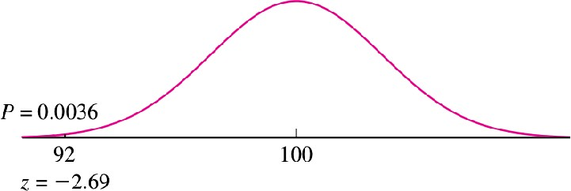
Result

Slide 39
P-value
●
The p-value is defined as the probability of observing an extreme value of a statistic X_bar, since the value of X_bar could come out differently if the experiment were repeated, under the assumption that the null hypothesis is true.
The P-value Is Not the Probability That H Is True : The
0
truth or falsehood of H cannot be changed by repeating
0
the experiment.
●
It measures the strength of the evidence against the null hypothesis.
How likely is the effect observed in your sample data if the null hypothesis is true?
It does not measure support for the alternative hypothesis.
The p-value is the probability that the data could deviate from the null hypothesis as much as they did or more.
●
●
●

Slide 40
Low P-value
●
Low P-values: your data are unlikely with a true null.
●
The smaller value of p-value, tells the investigator that the hypothesis under consideration may not adequately explain the observation.
●
A low P value suggests that your sample provides enough evidence that you can reject the null hypothesis for the entire population.
●
When the P-value is small, then we can be confident that the true value is really different.

Slide 41
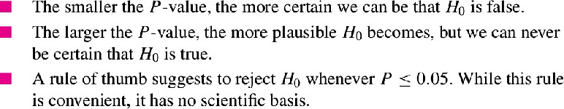
How low the P-value should be in order to reject H₀

Slide 42
Problem 2
Fill in the blank:
In a test of H : µ ≥ 10 versus H : µ < 10, the sample mean was
0 1
X_bar = 8 and the P-value was 0.04. This means that if µ = 10, and the experiment were repeated 100 times, we would expect to obtain a value of X_bar of 8 or less approximately times.
8
0.8
4
0.04
80

Slide 43
Problem 2 : Solution
(iii) 4.
●
The P-value is the probability, under the assumption that H₀ is true, of observing a result
as extreme as or more extreme than that actually observed.
Since P = 0.04, we expect to obtain a value of X less than or equal to 8 approximately 4 times in 100.
●

Slide 44
Significance Level
●
The significance level, also denoted as alpha or α, is used as a probability cutoff for making decisions about the null hypothesis.
Typical(Reasonable) values : 0.01, 0.05, 0.10.
When a result has a small P-value, we say that it is “statistically significant.”
●
●
Note: There is no scientifically valid dividing line between plausibility and implausibility, so it is impossible to specify a “correct” significance level below which we should reject H₀

Slide 45
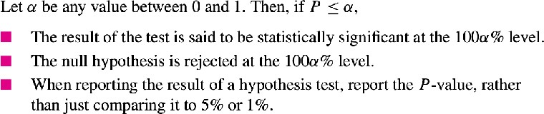
Statistical Significance

Slide 46
Conclusion in Hypothesis Test
Either is H₀ false and H₁ is true,
H₀ is plausible and therefore that H₁ is plausible as well.
Note: One can never conclude H₀ true and H₁ is false.

Slide 47
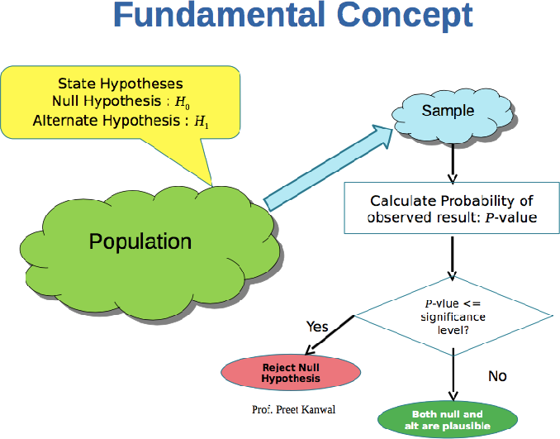

Slide 48
Problem 3
For which P-value is the null Hypothesis more plausible?
a) P = 0.05 b) P = 0.5

Slide 49
Problem 3 : Solution
b) P = 0.5. The larger the P-value, the more plausible the null hypothesis.

Slide 50
Problem 4
True or false:
If we reject H₀ , then we conclude that H₀ is false.
If we do not reject H₀ , then we conclude that H₀ is true.
If we reject H₀ , then we conclude that H₁ is true.
If we do not reject H₀ , then we conclude that H₁ is false.

Slide 51
Problem 4 : Solution
True.
False. We conclude that H 0 is plausible.
True.
False. We conclude that H 0 is plausible, and therefore that H 1 is plausible as well.

Slide 52
Problem 5
If P = 0.01, which is the best conclusion?
H₀ is definitely false.
H₀ is definitely true.
There is a 1% probability that H₀ is true. IV H₀ might be true, but it’s unlikely.
V H₀ might be false, but it’s unlikely. VI H₀ is plausible.

Slide 53
Problem 5 : Solution
(iv). A P-value of 0.01 means that if H₀ is true,
then the observed value of the test statistic was in the most extreme 1% of its distribution. This is unlikely, but not impossible.

Slide 54
Problem 6
If P = 0.50, which is the best conclusion?
H₀ is definitely false.
H₀ is definitely true.
Iii. There is a 50% probability that H₀ is true.
H₀ is plausible, and H₁ is false.
Both H₀ and H₁ are plausible.

Slide 55
Problem 6 : Solution
Option (v) A P-value of 0.50 means that if H₀ is
true, then the observed value of the test statistic was in the most extreme 50% of its distribution.
This is not at all unusual, so H₀ is plausible. We
can never conclude that H₁ is false.
●
So therefore we conclude that H₁ is plausible as well.
●

Slide 56
Problem 7
True or false: If P = 0.02, then
The result is statistically significant at the 5% level.
The result is statistically significant at the 1% level.
The null hypothesis is rejected at the 5% level.
The null hypothesis is rejected at the 1% level.

Slide 57
Problem 7 : Solution
True. The result is statistically significant at any level greater than or equal to 2%.
False. P > 0.01, so the result is not statistically significant at the 1% level.
True. The null hypothesis is rejected at any level greater than or equal to 2%.
False. P > 0.01, so the null hypothesis is not rejected at the 1% level.

Slide 58
Problem 8
George performed a hypothesis test.
Luis checked George’s work by redoing the calculations.
Both George and Luis agree that the result was statistically significant the 5% level, but they got different P-values.
George got a P-value of 0.20 and Luis got a P-value of 0.02.
●
●
●
Is it possible that George’s work is correct? Explain.
Is it possible that Luis’s work is correct? Explain.

Slide 59
Problem 8 : Solution
No. If the P-value is 0.20, then the result is not statistically significant at the 5% level.
Yes. If the P-value is 0.02, then the result is statistically significant at the 5% level.

Slide 60
Problem 9
Let µ be the radiation level to which a radiation worker is exposed during the course of a year.
The Environmental Protection Agency has set the maximum safe level of exposure at 5 rem per year.
If a hypothesis test is to be performed to determine whether a work-place is safe, which is the most appropriate null hypothesis:
●
H₀ : µ ≤ 5
H₀ : µ ≥ 5, or c) H₀ : µ = 5?

Slide 61
Problem 9 : Solution
Option (b)
Here, we wish to determine whether the work place is safe.
Hence,
●
H₁ = Place is safe, H₁ : µ < 5
H₀ = Place is not safe, H₀ : µ ≥ 5 (best choice)

Slide 62
Problem 10
A machine that fills cereal boxes is supposed to be calibrated so that the mean fill weight is 12 oz. Let µ denote the true mean fill weight. Assume that in a test of the hypotheses,
H : µ = 12 versus H : µ ≠ 12, the P-value is 0.30.
0 1
Should H be rejected on the basis of this test?Explain.
0
Can you conclude that the machine is calibrated to provide a mean fill weight of 12 oz? Explain.

Slide 63
Problem 10 : Solution
No. P = 0.30 is not small. Both the null and alternate hypotheses are therefore plausible.
No, we cannot conclude that the null hypothesis is true. The alternate hypothesis is also plausible.

Slide 64
Problem 11
A method of applying zinc plating to steel is supposed to produce a coating whose mean thickness is no greater than 7 microns. A quality inspector measures the thickness of 36 coated specimens and tests;
H₀ : µ ≤ 7 versus H₁ : µ > 7
She obtains a P-value of 0.40. Since P > 0.05, she concludes that the mean thickness is within the specification. Is this conclusion correct? Explain.

Slide 65
Problem 11 : Solution
No, she cannot conclude that the null hypothesis is true, only that it is plausible.

Slide 66
Problem 12
Recently many companies have been experimenting with telecommuting, allowing employees to work at home on their computers. Among other things, telecommuting is supposed to reduce the number of sick days taken. Suppose that at one firm, it is known that over the past few years employees have taken a mean of 5.4 sick days. This year, the firm introduces telecommuting. Management chooses a simple random sample of 80 employees to follow in detail, and, at the end of the year, these employees average 4.5 sick days with a standard deviation of 2.7 days. Let µ represent the mean number of sick days for all employees of the firm.
. Find the P-value for testing H : µ ≥ 5.4 versus H : µ < 5.4.
0 1
. Do you believe it is plausible that the mean number of sick days is at least 5.4, or are you convinced that it is less than 5.4? Explain your reasoning.

Slide 67
Problem 12(a) : Solution
X = 4.5, s = 2.7, n = 80. The null and alternate hypotheses are H 0 : µ ≥ 5.4 versus H 1 : µ < 5.4.
●
z = (4.5 − 5.4)/(2.7/ sqrt(80)) = −2.98. Since the alternate hypothesis is of the form µ < µ₀ , the
P-value is the area to the left of z = −2.98.
Thus P = 0.0014.
●

Slide 68
Problem 12(b) : Solution
If the mean number of sick days were 5.4, the probability of observing a sample mean less than or equal to the observed value of 4.5 would be 0.0014.
●
●
Since 0.0014 is a small probability, we are convinced that the mean number of sick days is less than 5.4.

Slide 69
Problem 13
The pH of an acid solution used to etch aluminum varies somewhat from batch to batch. In a sample of 50 batches the mean pH was 2.6, with a standard deviation of 0.3. Let µ represent the mean pH for batches of this solution.
Find the P-value for testing H₀ : µ ≤ 2.5 versus H₁ : µ > 2.5.
Either the mean pH is greater than 2.5 mm, or the sample is in the most extreme % of its distribution.

Slide 70
Problem 13(a) : Solution
X = 2.6, s = 0.3, n = 50. The null and alternate hypotheses are H 0 : µ ≤ 2.5 versus H 1 : µ > 2.5.
z = (2.6 − 2.5)/(0.3/ sqrt(50)) = 2.36.
Since the alternate hypothesis is of the form µ > µ₀ , the P-value is the area to the right of z = 2.36.
Thus P = 0.0091.
●
●

Slide 71
Problem 13(b) : Solution
(b) The P-value is 0.0091, so if H₀ is true then the
sample is in the most extreme 0.91% of its distribution.

Slide 72
Problem 14
Lasers can provide highly accurate measurements of small movements. To determine the accuracy of such a laser, it was used to take 100 measurements of a known quantity. The sample mean error was 25 µm with a standard deviation of 60 µm. The laser is properly calibrated if the mean error is µ = 0. A test is made of H₀ : µ = 0 versus H₁ : µ ≠ 0.
Find the P-value.
Do you believe it is plausible that the laser is properly calibrated, or are you convinced that it is out of calibration? Explain your reasoning.

Slide 73
Problem 14(a) : Solution
X = 25, s = 60, n = 100. The null and alternate hypotheses are H 0 : µ = 0 versus H 1 : µ = 0.
●
z = (25 − 0)/(60/ sqrt(100)) = 4.17.
Since the alternate hypothesis is of the form µ = µ 0 , the P-value is is the sum of the areas to the right of
z = 4.17 and to the left of z = −4.17.
●
●
Thus P ≈ 0.

Slide 74
Problem 14(b) : Solution
Since P-value is approx 0, we can reject H₀.
That means If H₀ was true that is the mean error were
0, the probability of observing a sample mean as far from 0 as the value of 25 that was actually observed would be nearly 0.
●
●
Therefore we are convinced that the mean error is not equal to 0. i.e. H₁ is true.

Slide 75
Fixed – Level Testing

Slide 76
Fixed – Level Testing
There is no scientifically valid dividing line between plausibility and implausibility, so it is impossible to specify a “correct” significance level below which we should reject H₀.
When possible, it is best simply to report the P-value, and not to make a firm decision whether or not to reject.
Sometimes, however, a decision has to be made.
If a decision is going to be made on the basis of a hypothesis test, there is no choice but to pick a cutoff point for the P-value.
When this is done, the test is referred to as a Fixed – Level Test.
●
●
●
●
●

Slide 77
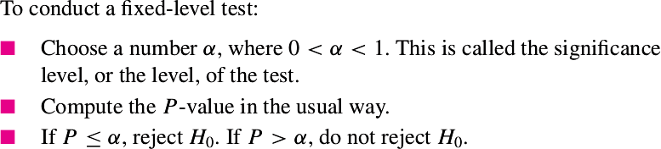
Summary

Slide 78
Rejection Region approach for Hypothesis Test

Slide 79
Critical Point & Rejection Region
●
In a fixed-level test, a critical point is a value of the test statistic that produces a P-value exactly equal to α.
●
The region on the side of the critical point that leads to rejection is called the rejection region.
●
The critical point itself is also in the rejection region.

Slide 80
Problem 1
A new concrete mix is being evaluated. The plan is to sample 100 concrete blocks made with the new mix, compute the sample mean compressive strength X , and then test,
H₀ : µ ≤ 1350 versus H₁ : µ > 1350
where the units are MPa.
●
It is assumed from previous tests of this sort that the population standard deviation σ will be close to 70 MPa.
Find the critical point and the rejection region if the test will be conducted at a significance level of 5%.
●

Slide 81
Problem 1 : Solution
●
α = 0.05
Since H : µ > 1350, its a right-tailed test.
1
z = 1.645 (Critical value)
Null distribution : X_bar ~ N(1350, 70²/100)
●
●
=> X_bar= z * s/sqrt(n) + 1350
=> X_bar= 1.645 * 70/sqrt(100) + 1350
=> X_bar = 1361.5 (Critical value can also be expressed this way)
●
The rejection region consists of all values of X_bar greater than or equal to 1361.5.

Slide 82
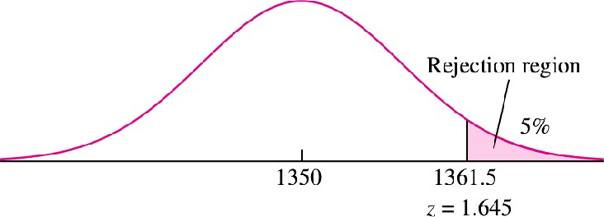
Problem 1 : Solution

Slide 83
Problem 2
●
A process for a certain type of ore is designed to reduce the concentration of impurities to less than 2%.
It is known that the standard deviation of impurities for processed ore is 0.6%.
Let µ represent the mean impurity level, in percent, for ore specimens treated by this process.
The impurity of 80 ore specimens is measured, and a test of the
●
●
●
hypothesis H : µ ≥ 2 versus H : µ < 2 will be performed.
0 1
If the test is made at the 5% level, what is the rejection region?
If the sample mean impurity level is 1.85, will H be rejected at the
0
10% level?
If the sample mean pH is 1.85, will H be rejected at the 1% level?
0
If the value X_bar = 1.9 is a critical point, what is the level of the test?

Slide 84
Problem 2(a) : Solution
●
Null distribution of X_bar:
X_bar ~ N(2, 0.6²/80)
α = 0.05
Since H1 : µ< 2, its a left-tailed test. Z = -1.645 (Critical value)
●
●
●
=> X_bar = z * s/sqrt(n) + 2
=> X_bar= -1.645 * 0.6/sqrt(80) + 2
=> X_bar = 1.890
Hence, H will be rejected if X ≤ 1.890. The rejection region
0
consists of all values of X less than or equal to 1.890.

Slide 85
Problem 2(b) : Solution without doing any calculation
Critical value at 5% level of X_bar = 1.890
●
b. If the sample mean impurity level is 1.85, will H₀ be rejected at the 10% level?
Since 1.85 < 1.890, H₀ will be rejected at 5%
level and hence will obviously be rejected at 10% level
●

Slide 86
Problem 2(b) : Solution using Rejection region approach
b. If the sample mean impurity level is 1.85, will H be rejected
at the 10% level?
H : µ ≥ 2 versus H : µ < 2
0 1
Null distribution of X_bar:
X_bar ~ N(2, 0.6²/80)
α = 0.10
Z = −1.28 (Critical value)
0
●
●
●
=> X_bar = z * s/sqrt(n) + 2
=> X_bar= -1.28 * 0.6/sqrt(80) + 2
=> X_bar = 1.9141
Since 1.85 < 1.9141 => H will be rejected at the 10% level
⁰Prof. Preet Kanwal

Slide 87
Problem 2(b) : Solution using P-value approach
b. If the sample mean impurity level is 1.85, will H be
rejected at the 10% level?
H : µ ≥ 2 versus H : µ < 2
0 1
Null distribution of X_bar:
X_bar ~ N(2, 0.6²/80)
α = 0.10
Finding z-score for 1.85
Z = (1.85 – 2)/ (0.6/sqrt(80)) = -2.24
=> P= P(Z < -2.24) = 0.0125
0
●
●
●
●
●
● => P < α => H will be rejected at the 10% level
0

Slide 88
Problem 2(c) : Solution using Rejection region approach
c. If the sample mean pH is 1.85, will H be rejected at the 1%
0
level?
H : µ ≥ 2 versus H : µ < 2
0 1
Null distribution of X_bar:
X_bar ~ N(2, 0.6²/80)
Α = 0.01
Z = -2.33 (Critical value)
●
●
=> X_bar = z * s/sqrt(n) + 2
=> X_bar= -2.33 * 0.6/sqrt(80) + 2
=> X_bar = 1.8437
Since 1.85 > 1.8437 => H will not be rejected at the 1% level
0

Slide 89
Problem 2(c) : Solution using P-value approach
c) If the sample mean pH is 1.85, will H be rejected at the 1% level?
0
H : µ ≥ 2 versus H : µ < 2
0 1
Null distribution of X_bar:
2
X_bar ~ N(2, 0.6 /80)
α = 0.01
Finding z-score for 1.85
Z = (1.85 – 2)/ (0.6/sqrt(80)) = -2.24
=> P= P(Z < -2.24) = 0.0125
●
●
●
●
● => P > α => H will not be rejected at the 1% level
0

Slide 90
Problem 2(d)
d. If the value 1.9 is a critical point, what is the level of the test?
H : µ ≥ 2 versus H : µ < 2
0 1
Null distribution of X_bar:
X_bar ~ N(2, 0.6²/80) Finding z – score for 1.9
Z = (1.9 – 2)/ (0.6/sqrt(80)) = -1.49
=> P(Z < -1.49) = 0.0681
=> level = α = 0.0681
●
●
●
●
●

Slide 91
Problem 3
A new braking system is being evaluated for a certain type of car.
●
The braking system will be installed if it can be conclusively demonstrated that the stopping distance under certain controlled conditions at a speed of 30 mi/h is less than 90 ft.
It is known that under these conditions the standard deviation of stopping distance is approximately 5 ft.
A sample of 150 stops will be made from a speed of 30 mi/h.
Let µ represent the mean stopping distance for the new braking system.
●
●
●
a) State the appropriate null and alternate hypotheses.

Slide 92
Problem 3
H₀ : µ ≥ 90 versus H₁ : µ < 90
b) Someone suggests rejecting H₀ if X_bar ≥ 89.4 ft. Is this an
appropriate rejection region, or is something wrong? If this is an appropriate rejection region, find the level of the test.
Otherwise explain what is wrong.
c). Someone suggests rejecting H₀ if X_bar ≤ 89.4 ft. Is this an
appropriate rejection region, or is something wrong? If this is an appropriate rejection region, find the level of the test.
Otherwise explain what is wrong.

Slide 93
Problem 3(b) : Solution
This is not an appropriate rejection region. Since H : µ < 90 => Left-tailed test
1
●
The rejection region should consist of values for X that will make the P-value of the test less than or equal to a chosen threshold level.
Therefore the rejection region must be of the form
X ≤ x
0
●
This rejection region is of the form X ≥ x , and so it consists of
0
values for which the P-value will be greater than some level.

Slide 94
Problem 3(c) : Solution
This is an appropriate rejection region. Since H₁ : µ < 90 => Left-tailed test
●
Under H 0 , the z-score of 89.4 is
(89.4 − 90)/ 5/sqrt(150)= −1.47.
Since the alternate hypothesis is of the form
µ < µ₀
level = P(Z < −1.47)
●
●
Therefore the level is α = 0.0708.

Slide 95
Relationship Between Hypothesis Tests
& Confidence Intervals

Slide 96
Introduction
●
In a hypothesis test for a population mean µ, we specify a particular value of µ (the null hypothesis) and determine whether that value is plausible.
In contrast, a confidence interval for a population mean µ can be thought of as the collection of all values for µ that meet a certain criterion of plausibility,specified by the confidence level 100(1 − α)
%.
●

Slide 97
Relationship
The values contained within a two-sided level 100(1−α)% confidence interval for a population mean µ are precisely those values for which the P-value of a two-tailed hypothesis test will be greater than α.
Example: the 95% confidence interval consists of precisely those values of µ whose P-values are greater than 0.05 in a hypothesis test.
●
●
A one-sided level 100(1 − α)% confidence interval consists of all the values for which the P-value in a one- tailed test would be greater than α.

Slide 98
Confidence level and P-values
The confidence level is equivalent to (1 – α) level.
So, if your significance level is 0.05, the corresponding confidence level is 95%.
If the P value is less than your significance (alpha) level, the hypothesis test is statistically significant.
If the confidence interval does not contain the null hypothesis value, the results are statistically significant.
If the P value is less than alpha, the confidence interval will not contain the null hypothesis value.
−
−

Slide 99
Example
Let the P value = 0.031
Significance level (α) = 0.05 => CL = 95%
Since P < α , our results are statistically significant.
●
●
●
●
Similarly, our 95% confidence interval [267, 394] does not include the null hypothesis mean of 260 and we draw the same conclusion.

Slide 100
Problem 1
A scientist computes the following use same data:
90% confidence interval to be (4.38, 6.02)
95% confidence interval to be (4.22, 6.18), and
99% confidence interval to be (3.91, 6.49).
●
●
●
Now she wants to test H 0 : µ = 4 versus H 1 : µ ≠ 4.
Regarding the P-value, which one of the following statements is true?
i. P > 0.10
ii. 0.05 < P < 0.10
iii. 0.01 < P < 0.05
iv. P < 0.01

Slide 101
Problem 1 : Solution
●
90% CI (4.38, 6.02) does not contain the value of null hypothesis (4). Hence, the result is statistically significant at 10%.
=> P-value < 0.10.
95% CI (4.22, 6.18) does not contain the value of null hypothesis (4). Hence, the result is statistically significant at 5%.
=>P-value < 0.05.
●
99% CI (3.91, 6.49) contains the value of null hypothesis (4). This means the result is not statistically significant at 1%.
=> P-value > 0.01
●
●
Option (iii) : 0.01 < P < 0.05

Slide 102
Problem 2
●
The strength of a certain type of rubber is tested by subjecting pieces of the rubber to an abrasion test.
For the rubber to be acceptable, the mean weight loss µ must be less than 3.5 mg.
A large number of pieces of rubber that were cured in a certain way were subject to the abrasion test.
A 95% upper confidence bound for the mean weight loss was computed from these data to be 3.45 mg.
Someone suggests using these data to test
●
●
●
●
H 0 : µ ≥ 3.5 versus H 1 : µ < 3.5.
Is it possible to determine from the confidence bound whether P < 0.05? Explain.
Is it possible to determine from the confidence bound whether P < 0.01? Explain.

Slide 103
Problem 2 : Solution
Yes.
Since 3.5 > 3.45 (upper confidence bound)
Quantities greater than the upper confidence bound will have P-values less than 0.05.
Therefore P < 0.05.
No, we would need to know the 99% upper confidence bound to determine whether P < 0.01.

Slide 104
Problem 3
A shipment of fibers is not acceptable if the mean breaking strength of the fibers is less than 50 N.
A large sample of fibers from this shipment was tested, and a 98% lower confidence bound for the mean breaking strength was computed to be 50.1 N.
Someone suggests using these data to test the hypotheses H 0 : µ ≤ 50 versus H 1 : µ > 50.
●
●
Is it possible to determine from the confidence bound whether P < 0.01? Explain.
Is it possible to determine from the confidence bound whether P < 0.05? Explain.

Slide 105
Problem 3 : Solution
No, we would need to know the 99% lower confidence bound in order to determine whether P < 0.01.
Yes, since 50 is less than the 98% lower confidence bound(50.1),
we know that P < 0.02. Therefore P < 0.05.

Slide 106
Statistical Significance vs.
Practical Significance

Slide 107
Statistical Significance Is Not the Same as Practical Significance
When a result has a small P-value, we say that it is “statistically significant.”
Sometimes statistically significant results do not have any scientific or practical importance.
●
●

Slide 108
Example
Assume that a process used to manufacture synthetic fibers is known to produce fibers with a mean breaking strength of 50 N.
A new process, which would require considerable retooling to implement, has been developed.
In a sample of 1000 fibers produced by this new method, the average breaking strength was 50.1 N, and the standard deviation was 1 N.
Can we conclude that the new process produces fibers with greater mean breaking strength?
●
●
●
●

Slide 109
Example :Solution
Let µ be the mean breaking strength of fibers produced by the new process. We need to test,
H 0 : µ ≤ 50 versus H 1 : µ > 50.
In this way, if we reject H 0 , we will conclude that the new process is better.
Under H0 , the sample mean X has a normal distribution with
●
mean 50 and
standard deviation 1/ sqrt(1000) = 0.0316.
The z-score is:
z = (50.1 − 50) / 0.0316 = 3.16
P -value = P(z > 3.16) = 0.0008

Slide 110
Result is Statistically Significant
The P-value is 0.0008. This is very strong evidence against H₀ .
The new process produces fibers with a greater mean breaking strength.
●
●

Slide 111
Result is not Practically Significant
What practical conclusion should be drawn from this result?
On the basis of the hypothesis test, we are quite sure that the new process is better.
Would it be worthwhile to implement the new process? Probably not.
The reason is that the difference between the old and new processes, although highly statistically significant, amounts to only 0.1 N.
It is unlikely that this is difference is large enough to matter.
●
●
●

Slide 112
Conclusion
●
Result can be statistically significant without being large enough to be of practical importance.
The P-value does not measure practical significance.
●
Reason:
When the standard deviation is very small, even a small difference can be statistically significant.

Slide 113
Z-tests for
Difference between Two Population Means of Large Samples.
(Section 6.5)

Slide 114
Introduction
We wish to determine whether the means of two populations are equal.
The data will consist of two samples, one from each population.
We will compute the difference of the sample means.
If the difference is far from 0, we will conclude that the population means are different.
If the difference is close to 0, we will conclude that the population means might be the same.
●
●
●
●
●

Slide 115

Null Distribution of
The test is based on .
●
●
Since both sample sizes are large, X and Y are both approximately normally distributed.
Since the samples are independent, it follows that the null distribution of is:
●

Slide 116
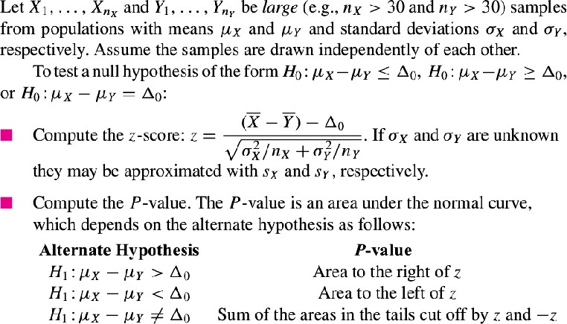
Z-tests for Difference between Two Population Means of Large Samples.

Slide 117
Problem 1
The article “Wired: Energy Drinks, Jock Identity, Masculine Norms, and Risk Taking” (K. Miller, Journal of American College Health, 2008:481–
489) reports that in a sample of 413 male college students, the average number of energy drinks consumed per month was 2.49 with a standard deviation of 4.87, and in a sample of 382 female college students, the average was 1.22 with a standard deviation of 3.24.
Can you conclude that the mean number of energy drinks is greater for male students than for female students^{P}?^{rof. Preet Kanwal}

Slide 118
Problem 1 : Solution
(male students) X = 2.49
1.22
s = 4.87
X
n = 413
X
(female students)
Y =
s = 3.24
Y
n = 382
Y
●
Can you conclude that the mean number of energy drinks is greater for male students than for female students?
H : µ − µ ≤ 0 versus H : µ − µ > 0
0 X Y 1 X Y
Prof. Preet Kanwal

Slide 119
Problem 1 : Solution
●
Null Distribution(0, 3.24²/382 + 4.87²/413)
(2.49−1.22−0)
-------------------------- sqrt(3.24²/382 + 4.87²/413)
●
test-statistic, z =
=> z = 4.36.
P = P(Z > 4.36) ≈ 0
Since P < 0.05 , We can reject H₀ and accept H₁.
Hence, we can conclude that the mean number of energy drinks is greater for male students than for female students
●
●
●
Prof. Preet Kanwal

Slide 120
Problem 2
Two machines used to fill soft drink containers are being compared. The number of containers filled each minute is counted for 60 minutes for each machine. During the 60 minutes, machine 1 filled an average of 73.8 cans per minute with a standard deviation of 5.2 cans per minute, and machine 2 filled an average of 76.1 cans per minute with a standard deviation of 4.1 cans per minute.
Assuming that all necessary assumptions are met, perform a hypothesis test. Can you conclude that machine 2 is faster than machine 1?
Prof. Preet Kanwal

Slide 121
Problem 2 : Solution
(machine 1)
X = 73.8
s_{X} = 5.2
n_{X} = 60
(machine 2)
Y = 76.1
s_{Y} = 4.1
n_{Y} = 60
Can you conclude that machine 2 is faster than machine 1?
H₀ : µ_{X} − µ_{Y} ≥ 0 versus H₁ : µ_{X} − µ_{Y} < 0
●
Prof. Preet Kanwal

Slide 122
Problem 2 : Solution
(73.8 – 76.1) – 0
●
test-statistic, z = -------------------------- sqrt(5.2²/60 + 4.1²/60)
=> z = −2.69
●
Since its a left-tailed test,
P = P(Z < -2.69) = 0.0036
Since P < 0.05 we reject H₀ and accept H₁.
●
Hence, we conclude machine 2 is faster than machine 1.
Prof. Preet Kanwal

Slide 123
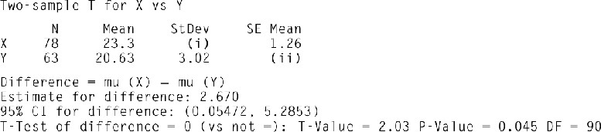
Problem 3
The following MINITAB output presents the results of a hypothesis test for the difference µ_{X} − µ_{Y} between two population means. Some of the numbers are
missing.
Fill in the missing numbers for (i) and (ii).
The output presents a Student’s t test. Compute the P-value using a z test. Are the two results similar?
Compute a 98% confidence interval for µ_{X} − µ_{Y} based on the z statistic.
Prof. Preet Kanwal

Slide 124
Problem 3 : Solution
(a) (i) StDev = (SE Mean) * √N = 1.26 * √78 = 11.128 (ii) SE Mean = StDev / √N = 3.02 /√63 = 0.380484
(b) z = (23.3 − 20.63 − 0)/ √(1.26² + 0.380484²) = 2.03.
Since the alternate hypothesis is of the form µ − µ ≠ 0, the P-value
●
X Y
is the sum of the areas to the right of z = 2.03 and to the left of z =
−2.03.
●
Thus P = 0.0212 + 0.0212 = 0.0424, and the result is similar to that of the t test.
Prof. Preet Kanwal

Slide 125
Problem 3 : Solution
98% confidence interval for µ_{X} − µ_{Y} :
X = 23.3
Y = 20.63
Z _{.01} = 2.33
s_{X} / √n_{X} = 1.26 s_{Y} / √n_{Y} = 0.380484
The 98% confidence interval is:
23.3 − 20.63 ± 2.33 √(1.26² + 0.380484²)
= (−0.3967, 5.7367).
Prof. Preet Kanwal

Slide 126
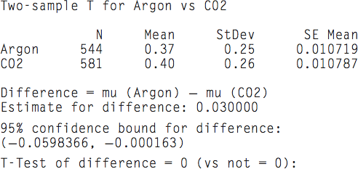
Problem 4
What can you say about the P-value??
Prof. Preet Kanwal

Slide 127
Problem 4 : Solution
Since the value 0 is not present in the 95% CI, we can say P-value <= 0.05
Prof. Preet Kanwal

Slide 128
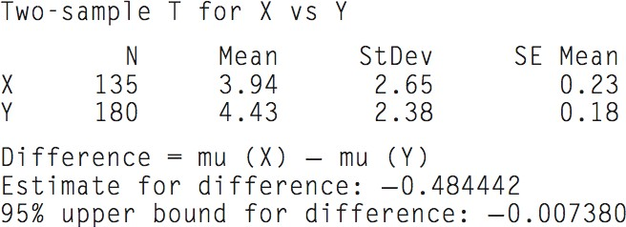
Problem 5
Test of difference = 0 (vs <)
Which tailed test is it?
What can you say about the P-value?
Prof. Preet Kanwal

Slide 129
Problem 5 : Solution
Test of difference = 0 (vs <)
Which tailed test is it? Left-Tailed Test
What can you say about the P-value? P-value < 0.05 as the Upper bound CI is unable to cover the value 0.
Prof. Preet Kanwal

Slide 130
Z-tests for
Population Proportions of
Large Samples (Section 6.3)
Prof. Preet Kanwal

Slide 131
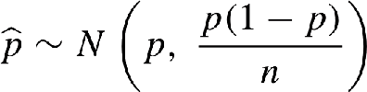
Null distribution of p_hat
Null distribution of p_hat,
●
●
p is approximated by using p0 value.
Prof. Preet Kanwal

Slide 132
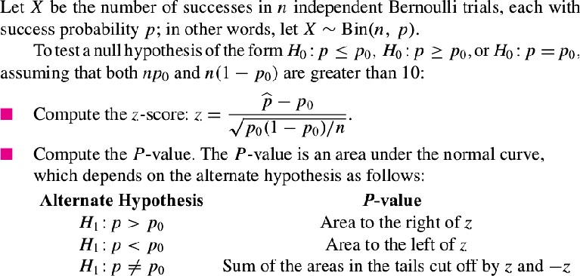
Z-tests for Population Proportions of Large Samples
Prof. Preet Kanwal

Slide 133
Relationship with Confidence Intervals for a Proportion
A level 100(1−α)% confidence interval for a population proportion p contains those values for a parameter for which the P-value of a hypothesis test will be greater than α.
Prof. Preet Kanwal

Slide 134
Problem 1
A random sample of 300 electronic components manufactured by a certain process are tested, and 25 are found to be defective.
Let p represent the proportion of components manufactured by this process that are defective.
The process engineer claims that p ≤ 0.05.
Does the sample provide enough evidence to reject the claim?
●
●
●
Prof. Preet Kanwal

Slide 135
Problem 1 : Solution
p_hat = 25 /300 = 0.083
The process engineer claims that p ≤ 0.05.
H : p ≤ 0.05 versus H : p > 0.05
0 1
Null distribution :
p_hat ~ N(p , p(1 – p)/n)
(0.083 – 0.05)
●
●
●
Z = --------------------- sqrt(0.05 (1 – 0.05)/ 300)
=> Z = 2.62
=> P = P(Z > 2.62) = 0.0044
Note that under the commonly used rule of thumb, we would reject H and
0
reject process engineer's claim. Hence, sample provides enough evidence.
Prof. Preet Kanwal

Slide 136
Problem 2
The article “Application of Surgical Navigation to Total Hip Arthroplasty” (T. Ecker and S. Murphy, Journal of Engineering in Medicine, 2007:699– 712) reports that in a sample of 113 people undergoing a certain type of hip replacement surgery on one hip, 65 of them had surgery on their right hip.
Can you conclude that frequency of this type of surgery differs between right and left hips?
Prof. Preet Kanwal

Slide 137
Problem 2 : Solution
p_hat = 65/113 = 0.575
Can you conclude that frequency of this type of surgery differs between right and left hips?
H : p = 0.5 versus H : p ≠ 0.5
0 1
(0.575 – 0.5)
z = --------------------------- sqrt(0.5(1 -0.5)/113)
=> z = 0.075/0.047 = 1.596 ≈ 1.60
Since its a two tailed test,
P = P(Z < -1.60) + P(Z > 1.60) = 0.0548 + 0.0548 = 0.1096
We cannot conclude that the frequency of this type of surgery differs between right and left hips.
Prof. Preet Kanwal

Slide 138
Problem 3
During a recent drought, a water utility in a certain town sampled 100 residential water bills and found that 73 of the residences had reduced their water consumption over that of the previous year.
Can it be concluded that more than 60% of the residences in the town reduced their water consumption?
Prof. Preet Kanwal

Slide 139
Problem 3 : Solution
p_hat = 73/100 = 0.73
Can it be concluded that more than 60% of the residences in the town reduced their water consumption?
H : p ≤ 0.60 versus H : p > 0.60
0 1
(0.73 – 0.60)
z = --------------------------- sqrt(0.60(1 – 0.60)/100)
=> z = 2.65
=> P = P(Z > 2.65) = 0.0040
Hence we can conclude that more than 60% of the residences in the town reduced their water consumption.
Prof. Preet Kanwal

Slide 140

Problem 4
The following output presents the results of a hypothesis test for a population proportion p. Some of the numbers are missing. Fill in the numbers for (a) through (c). Test of p ≥ 0.7 vs p < 0.7
Prof. Preet Kanwal

Slide 141
Problem 4 : Solution
a) Sample p = p_hat = 345/500 = 0.690.
The null and alternate hypotheses are
H : p ≥ 0.7 versus H : µ < 0.7.
0 1
n = 500.
From part (a), p_hat = 0.690.
z = (0.690 − 0.700)/ sqrt(0.7(1 − 0.7)/500) z = −0.49.
Since the alternate hypothesis is of the form p < p 0 , the P-value is the area to the left of z = −0.49.
Thus P = P(Z < -0.49) = 0.3121.
Prof. Preet Kanwal

Slide 142
Z-test for
Difference between Two Population proportions of Large Samples.
(Section 6.6)
Prof. Preet Kanwal

Slide 143


Introduction
The test is based on the statistic .
Determining the null distribution of statistic
●
By the Central Limit Theorem, since n_{X} and n_{Y} are both large,
Therefore,
Prof. Preet Kanwal

Slide 144
Pooling
●
"Pooling" is the name given to a technique used to obtain a more precise estimate of the standard deviation of a sample statistic by combining the estimates given by two (or more) independent samples.
When performing tests (or calculating confidence intervals) for a difference of two means, we do not pool. In other statistical situations we may or may not pool.
We always use a pooled estimate of the standard deviation (based on a pooled estimate of the proportion) when carrying out a hypothesis test whose null hypothesis is p1 = p2 (or equivalently, p1 - p2 = 0 ).
If they are actually equal, then combining them gives a better estimate of the standard error than keeping them separate.
●
●
●
Prof. Preet Kanwal

Slide 145

Pooled Proportion
However, the null hypothesis H₀ specifies that the population proportions are equal.
Therefore we must estimate them both p_{X} and p_{Y} with a common value.
The appropriate value is the pooled proportion,
●
●
Prof. Preet Kanwal

Slide 146



Null distribution of
The null distribution of estimated as,
i
s therefore
Where,
pooled proportion =
Prof. Preet Kanwal

Slide 147
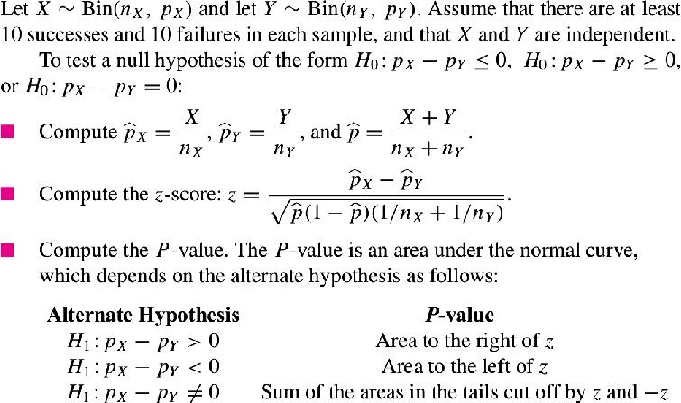
Summary
Prof. Preet Kanwal

Slide 148
Problem 1 - Description
A mobile computer network consists of computers that maintain wireless communication with one another as they move about a given area. A routing protocol is an algorithm that determines how messages will be relayed from machine to machine along the network, so as to have the greatest chance of reaching their destination.
An article compares the effectiveness of two routing protocols over a variety of metrics, including the rate of successful deliveries.
Prof. Preet Kanwal

Slide 149
Problem 1
●
Assume that using protocol A, 200 messages were sent, and 170 of them, or 85%, were successfully received.
Using protocol B, 150 messages were sent, and 123 of them, or 82%, were successfully received.
●
Can we conclude that protocol A has the higher success rate?
Prof. Preet Kanwal

Slide 150
Problem 1 - Solution
Let X represent the number of messages successfully sent using protocol A.
X ~ Bin(200, p )
X
p _hat = 170/200 = 0.85
X
●
Let Y represent the number of messages successfully sent using protocol B.
Y ~ Bin(150, p )
Y
p _hat = 123/150 = 0.82
Y
●
Prof. Preet Kanwal

Slide 151
Problem 1 - Solution
Can we conclude that protocol A has the higher success rate?
H₀ : p_{X} - p_{Y} ≤ 0 versus H₁ : p_{X} - p_{Y} > 0
Pooled proportion,
p_hat = (170 + 123) /(200 + 150) = 0.837
Null distribution of
~ N(0, 0.0399)
Test-statistic, z = (p_{X}_hat – p_{Y}_hat) – 0/SE
=> z = (0.85 – 0.82)/ 0.0399 = 0.75
P = P(Z > 0.75) = 0.2266 => Both null and alt are plausible.
,
Prof. Preet Kanwal

Slide 152
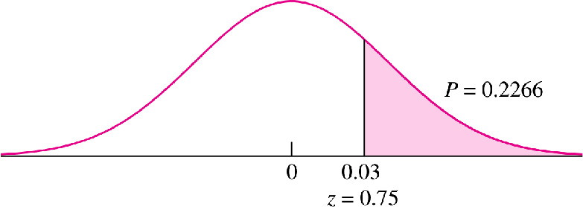
Problem 1 - Solution
Prof. Preet Kanwal

Slide 153
Problem 2
●
Two extrusion machines that manufacture steel rods are being compared.
In a sample of 1000 rods taken from machine 1, 960 met specifications regarding length and diameter.
In a sample of 600 rods taken from machine 2, 582 met the specifications.
Machine 2 is more expensive to run, so it is decided that machine 1 will be used unless it can be convincingly shown that machine 2 produces a larger proportion of rods meeting specifications.
●
●
●
State the appropriate null and alternate hypotheses for making the decision as to which machine to use.
Compute the P-value.
Which machine should be used?
Prof. Preet Kanwal

Slide 154
Problem 2 : Solution
●
Let X represent rods manufactured using Machine 1 meeting specifications.
X ~ Bin(1000, p )
X
p _hat = 960/1000 = 0.96
X
Let Y represent rods manufactured using Machine 2 meeting specifications.
Y ~ Bin(600, p )
Y
p _hat = 582/600 = 0.97
Y
●
To show that machine 2 produces a larger proportion of rods meeting specifications, we need to test,
H : p - p ≥ 0 versus H : p - p < 0
0 X Y 1 X Y
Prof. Preet Kanwal

Slide 155

Problem 2 : Solution
Pooled proportion,
p_hat = (960 + 582)/(1000 + 600) = 0.96375
Test-statistic:
Since its left tailed test, P = P(Z < -1.04) = 0.1492
Since P > 0.05 => We cannot reject H_{0.}
●
Hence, machine 1 must be used, as we could not prove that machine 2 produces larger proportion of rods meeting specifications.
Prof. Preet Kanwal

Slide 156
Problem 3
In a study conducted by the U.S. Department of Health and Human Services,
A sample of 546 boys aged 6–11 was weighed, and it was determined that 87 of them were overweight.
A sample of 508 girls aged 6–11 was also weighed, and 74 of them were overweight.
●
Can you conclude that the proportion of boys who are overweight differs from the proportion of girls who are overweight?
Prof. Preet Kanwal

Slide 157
Problem 3 : Solution
Let X represent no of boys that are overweight
X ~ Bin(546, p )
X
●
p _hat = 87/546 = 0.159
X
Let Y represent no of girls that are overweight
Y ~ Bin(508, p )
Y
p _hat = 74/508 = 0.146
Y
●
●
Can you conclude that the proportion of boys who are overweight differs from the proportion of girls who are overweight?
H : p - p
0 X Y
= 0 versus H : p - p ≠ 0
1 X Y
Prof. Preet Kanwal

Slide 158

Problem 3 : Solution
●
Pooled proportion,
p_hat =(87 + 74)/(546 + 508) = 0.15275
●
Test-statistic:
●
Since its two tailed test,
P = P(Z < -0.62) + P(Z > 0.62 )= 0.2676 + 0.2676 = 0.5352
Since P > 0.05 => We cannot reject H_{0.}
●
Hence cannot conclude that the proportion of boys who are overweight differs from the proportion of girls who are overweight
Prof. Preet Kanwal

Slide 159
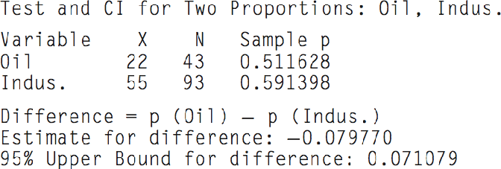
Problem 4
Test for difference = 0 (vs < 0)
What can you say about the P-value?
Prof. Preet Kanwal

Slide 160
Problem 4 : Solution
Test for difference = 0 (vs < 0)
What can you say about the P-value? Since the 95% Upper confidence bound covers the value 0; P-value > 0.05.
Prof. Preet Kanwal

Slide 161
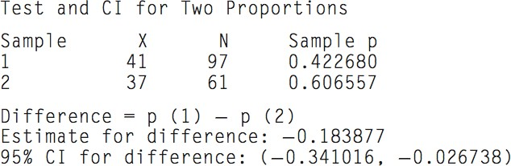
Problem 5
Test for difference = 0 (vs not = 0) What can you say about the P-value?
Prof. Preet Kanwal

Slide 162
Problem 5 : Solution
Test for difference = 0 (vs not = 0)
What can you say about the P-value? Since the 95% CI does not cover the value 0; P-value <= 0.05.
Prof. Preet Kanwal

Slide 163
Tests with
Paired Data (Section 6.8)
Prof. Preet Kanwal

Slide 164
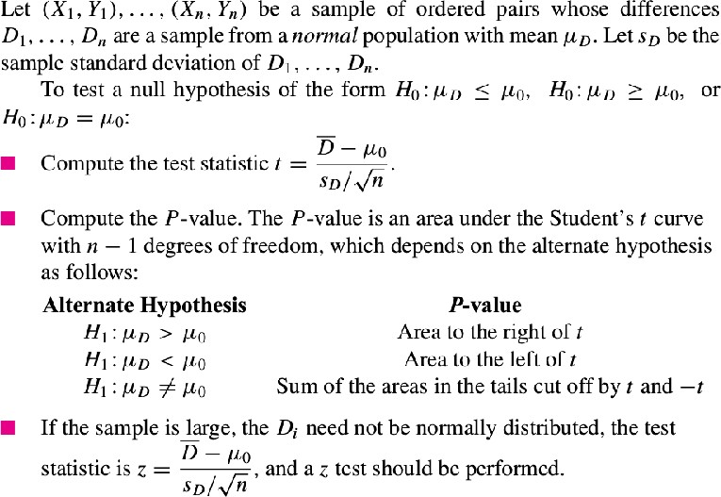
Prof. Preet Kanwal

Slide 165
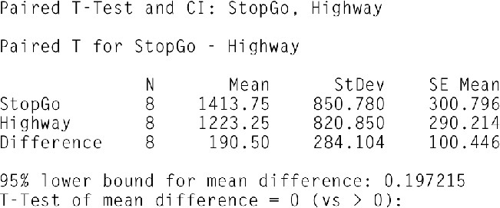
Problem 1
Given the data, Can we conclude that the mean level of emissions is less for highway driving than for stop-and-go driving?
Prof. Preet Kanwal

Slide 166


Problem 1 : Solution
●
The null and alternate hypotheses are
●
The test statistic is
=> P = P(t > 1.897) ≈ 0.050
Hence we can reject null hypothesis and conclude that mean level of emissions is less for highway driving than for stop-and-go driving.
●
●
Prof. Preet Kanwal

Slide 167
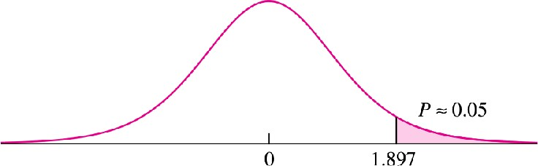
Problem 1 : Solution
Prof. Preet Kanwal

Slide 168
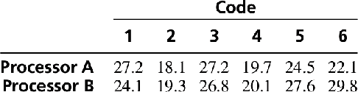
Problem 2
Two microprocessors are compared on a sample of six benchmark codes to determine whether there is a difference in speed. The times (in seconds) used by each processor on each code are given in the following table. Can you conclude that the mean speeds of the two processors differ?
Prof. Preet Kanwal

Slide 169
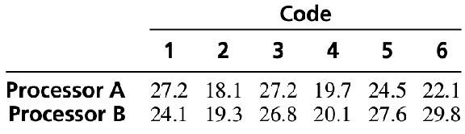

Problem 2 : Solution
Differences
3.1 −1.2 0.4 −0.4 −3.1
−7.7
D_bar = −1.48333, s D = 3.6625, n = 6.
t = (−1.48333 − 0)/(3.6625/ sqrt(6)) = −0.9921. P = P(t < -0.9921) + P(t > 0.9921) =
0.10 < P(t > 0.9921) < 0.25
●
●
=> P > 0.05, Hence we cannot reject null hypothesis & both null and alt are p^{P}l^{r}a^{of.}u^{P}s^{ree}ib^{t K}lªe^{nw}.^{al}

Slide 170
Errors In Hypothesis Testing

Slide 171
Introduction
One can reject H₀ when it is in fact true. This is known as a type I error.
Or, one can fail to reject H₀ when it is false. This is known as a type II error.
●
Since a fixed-level test results in a firm decision, there is a chance that the decision could be the wrong one.
There are exactly two ways in which the decision can be wrong:
●
●
●

Slide 172
Type I error (a "false positive")
●
When the null hypothesis is true and you reject it, you make a type I error.
The probability of making a type I error is α, which is the level of significance you set for your hypothesis test.
An α of 0.05 indicates that you are willing to accept a 5% chance that you are wrong when you reject the null hypothesis.
To lower this risk, you must use a lower value for α.
However, using a lower value for alpha means that you will be less likely to detect a true difference if one really exists.
●
●
●
●

Slide 173
Problem 1
A hypothesis test is to be performed, and it is decided to reject the null hypothesis if P ≤ 0.10. If H₀ is in fact true, what is the maximum
probability that it will be rejected?

Slide 174
Problem 1 : Solution
The maximum probability of rejecting H₀ when true is the level α = 0.10.

Slide 175
Type II error (a "false negative")
When the null hypothesis is false and you fail to reject it, you make a type II error.
The probability of making a type II error is β, which depends on the power of the test.
You can decrease your risk of committing a type II error by ensuring your test has enough power.
You can do this by ensuring your sample size is large enough to detect a practical difference when one truly exists.
●
●
●
●

Slide 176
Generally
●
Null Hypothesis : No effect
Type I Error / False Positive
Detects an effect when there is no effect. (False Alarm)
Type II Error / False Negative
Fails to detect an effect, when it is actually present.

Slide 177
Example : Spam Filter

Slide 178

SPAM vs. HAM
●
The statistics about an email filter's effectiveness are built upon the concept of false positives and false negatives.
H0: It is not a spam vs. H1: It is a spam
A false positive may be an important message that ends up in your spam folder or, much worse, gets deleted.
A false negative (spam that ends up in your inbox) is annoying.
POPFile is an email classifier that happens to be very good at filtering spam.
●
●
●

Slide 179

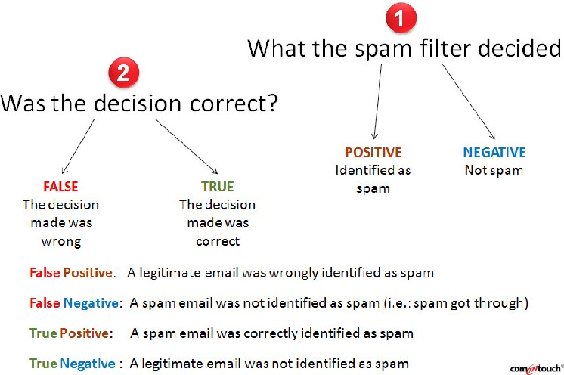


Hypothesis test result
Reality

Slide 180
 |  | Reality
 |  | H0 is true (It is not a spam) | H0 is false (It is a spam)
Result of Hypothesis Testing | Reject H0 (classified as spam) | False Positive (Type I error) | True Positive Test result :
(Your decision or Prediction) |  | Test result : positive (its a spam) | Positive (its a spam)
 |  | But in reality its a legitimate message | and ends up in spam folder.
 |  | False Positive: | Hence, True positive
 |  | Legitimate message ends up in a spam folder)
 | Failed to Reject H0 | True Negative | False Negative
 | (identified as a legitimate message) | Test result : Negative(not a spam); and ends up inbox | (Type II error) Test result : Negative(not a spam)
 |  | True Negative | But, in reality It is.
 |  |  | Spam shows up in inbox
 |  |  | False negative
S

Slide 181

Prof. Preet Kanwal

Slide 182
Other Examples

Slide 183
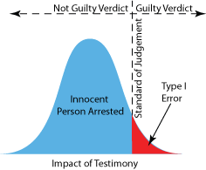
Example 1
●
Null Hypothesis: Person is not guilty of the crime
●
Type I Error / False Positive
Person is judged as guilty when the person actually did not commit the crime (convicting an innocent person)
●
Type II Error / False Negative
Person is judged not guilty when they actually did commit the crime (letting a guilty person go free)

Slide 184
Example 2
●
Null Hypothesis : A person is not Hiv – infected
●
Type I Error / False Positive
A false positive result is an incorrect HIV-positive diagnosis in a person who is not actually infected.
●
Type II Error / False Negative
A false negative result is a failure to correctly identify an HIV-infected person as HIV-positive.

Slide 185
 |  | Reality
 |  | H0 is true (person is not HIV positive) | H0 is false (person is HIV positive)
Result of Hypothesis Testing (Your decision or | Reject H0 (detected as HIV- positive) | False Positive (Type I error) Test result : positive | True Positive Test result : Positive
Prediction) |  | But in reality He is not HIV positive. Hence, False Positive | And in reality he is HIV Positive :
 |  |  | Hence, True positive
 | Failed to Reject H0 | True Negative | False Negative
 | (Not detected as HIV- positive) | Test result : Negative; and in reality he is not infected : True Negative | (Type II error) Test result : Negative But in reality he is HIV positive.
 |  |  | False negative

Slide 186
Example 3 : Quality Control
●
Null Hypothesis : Product satisfies the customer's specifications
Type I Error / False Positive
Rejected the product, and was not sold to the customers(results in loss as a good product is rejected)
Type II Error / False Negative
Failed to reject the product : Accepted bad product and was sold to the customers(can result in losing the customer's and company's position is at stake)

Slide 187
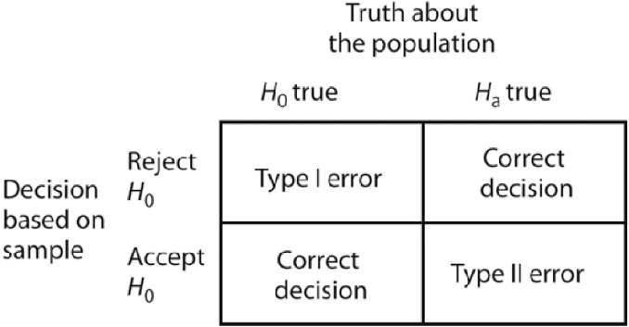
Summary

Slide 188
Summary
 |  | Reality
 |  | H0 is true | H0 is false
Result of Hypothesis Testing | Reject H0 | False Positive (Type I error) | True Positive
(Your decision or
Prediction)
 | Failed to Reject H0 | True Negative | False Negative
 |  |  | (Type II error)

Slide 189
Problem 2
A test is made of the hypotheses:
H 0 : µ ≤ 10 versus H 1 : µ > 10
For each of the following situations, determine whether the decision was correct, a type I error occurred, or a type II error occurred.
µ = 8, H is rejected.
0
µ = 10, H is not rejected.
0
µ = 14, H is not rejected.
0
µ = 12, H is rejected.
0

Slide 190

Problem 2 : Solution
H 0 : µ ≤ 10 versus H 1 : µ > 10
µ = 8, H is rejected
0
Type I error. H is true and was rejected.
0
µ = 10, H is not rejected
0
False positive
Correct decision. H is true and was not rejected.
0
True negative
µ = 14, H is not rejected
0
Type II error. H is false and was not rejected.
0
µ = 12, H is rejected
0
False negative
Correct decision. H is false and was rejected. True positive
0

Slide 191
Problem 3
●
A new process is being considered for the liquefaction of coal. The old process yielded a mean of 15 kg of distillate fuel per kilogram of hydrogen consumed in the process.
Let µ represent the mean of the new process. Following test is performed
H : µ ≤ 15 versus H : µ > 15
0 1
●
The new process will be put into production if H is rejected.
0
Putting the new process into production is very expensive.
Therefore it would be a costly error to put the new process into production if in fact it is no better than the old process.
Which procedure provides a smaller probability for this error, to test at the 5% level or to test at the 1% level?
●
●

Slide 192
Problem 3 : Solution
The 1% level.
The error in question is rejecting H₀ when true, which is a type I error.
When the level is smaller, it is less likely to reject H₀ , and thus less likely to make a type I
error.
●
●
●

Slide 193
Power of a Test

Slide 194
Introduction
In order for a test to be useful, a test must have reasonably small probabilities of both type I and type II errors.
The type I error is kept small by choosing a small value of α as the significance level.
Then the power of the test is calculated. If the power is large, then the probability of a type II error is small as well, and the test is a useful one.
●
●
●

Slide 195
Power of a Test
●
The power of a test is the probability of rejecting H₀ when it is false.
Power = 1 − P(type II error)
Power calculations are generally done before data are collected.
The purpose of a power calculation is to determine whether or not a hypothesis test, when performed, is likely to reject H₀ in the event that H₀ is false.
●
●

Slide 196
Computing Power
In order to compute the power, it is necessary to specify a particular value of µ, because:
power is different for different values of µ
if µ is close to H :
0
the power will be small if µ is far from H :
0
the power will be large
●
Compute the rejection region.
Compute the probability that the test statistic falls in the rejection region if the alternate hypothesis is true. This is the power.
●
●

Slide 197
Alternate distribution
●
The alternate distribution is obtained by shifting the null distribution to chosen value of µ.
●
If the alternate mean is chosen very close to the null mean, the alternate curve will be almost identical with the null, and the power will be very close to α.
●
If the alternate mean is far from the null, almost all the area under the alternate curve will lie in the rejection region, and the power will be close to 1.

Slide 198
How large the power must be for a test
●
As with P-values, there is no scientifically valid dividing line between sufficient and insufficient power.
In general, tests with power greater than 0.80 or perhaps 0.90 are considered acceptable, but there are no well-established rules of thumb.
●

Slide 199
Problem 1
Find the power of the 5% level test of
H 0 : µ ≤ 80 versus H 1 : µ > 80
for the mean yield of the new process under the alternative µ = 81, assuming n = 50 and σ = 5.

Slide 200
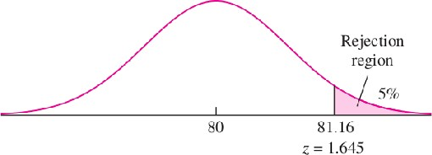
Critical Point
Null distribution of X_bar :
X_bar ~ N(80, 5² /50)
The critical point has a z-score of 1.645, so its value is 80 + (1.645)(0.707) = 81.16.
●
●

Slide 201
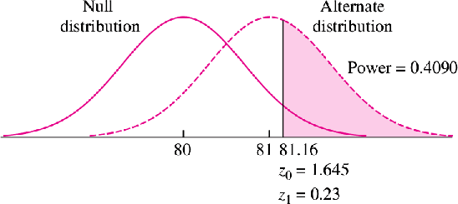
Computing the power
●
Power is the probability that X_bar will fall into the rejection region if the alternate hypothesis µ = 81 is true.
ALternate distribution of X_bar :
X_bar ~ N(81, 5² /50)
●
Z₁ = (81.16 − 81)/0.707 => z₁
= 0.23

Slide 202
Conclusion
●
A power of 0.4090 is very low.
It means that if the mean yield of new process is actually equal to 81, there is only a 41% chance that the proposed experiment will detect the improvement over the old process and allow the new process to be put into production.
●
●
It would be unwise to invest time and money to run this experiment, since it has a large chance to fail.

Slide 203
Problem 2
Find the power of the 5% level test of
H 0 : µ ≤ 80 versus H 1 : µ > 80
for the mean yield of the new process under the alternative µ = 82, assuming n = 50 and σ = 5.

Slide 204
Critical Point
Null distribution of X_bar :
X_bar ~ N(80, 5² /50)
The critical point has a z-score of 1.645, so its value is 80 + (1.645)(0.707) = 81.16.
●
●

Slide 205
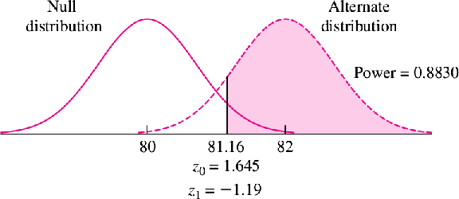
Computing the power
●
Power is the probability that X_bar will fall into the rejection region if the alternate hypothesis µ = 82 is true.
Null distribution of X_bar :
X_bar ~ N(82, 5² /50)
●
Z₁ = (81.16 − 82)/0.707 => z₁
= −1.19

Slide 206
Conclusion
●
A power of 0.8830 is high.
●
It means that if the mean yield of new process is actually equal to 81, there is a 88.30% chance that the proposed experiment will detect the improvement over the old process and allow the new process to be put into production.
●
It would be a wise decision to invest time and money to run this experiment, since it has a large chance to succeed.

Slide 207
Note:
When power is not large enough, it can be increased by increasing the sample size.

Slide 208
Problem 3
In testing the hypothesis:
H0 : µ ≤ 80 versus H1 : µ > 80
regarding the mean yield of the new process, how many times must the new process be run so that a test conducted at a significance level of 5% will have power 0.90 against the alternative µ = 81, if it is assumed that σ = 5?

Slide 209
Critical Point
Null distribution of X_bar :
X_bar ~ N(80, 5² /n)
The critical point has a z-score of 1.645, so its value is 80 + (1.645) * 5 / sqrt(n)
●
●

Slide 210
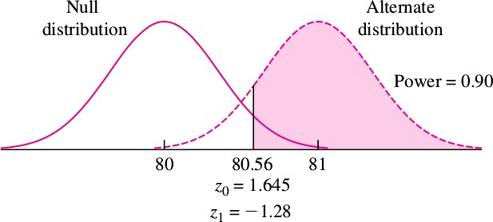
Power
●
The power of the test is the area of the rejection region under the alternate curve. This area must be 0.90.
The critical point is therefore 81 − 1.28(5/ sqrt (n)) .
●
●
po e
Prof. P_{t}reet Kanwal
the

Slide 211

Solving for n
Since there is only one critical point, these two expressions are equal. We therefore set them equal and solve for n.
●
n ≈ 214.
The critical point is 80.56.
●
●

Slide 212
Problem 4
●
A pollster will conduct a survey of a random sample of voters in a community to estimate the proportion who support a measure on school bonds.
Let p be the proportion of the population who support the measure. The pollster will test:
H 0 : p = 0.50 versus H 1 : p ≠ 0.50
●
at the 5% level. If 200 voters are sampled, what is the power of the test if the true value of p is 0.55?

Slide 213
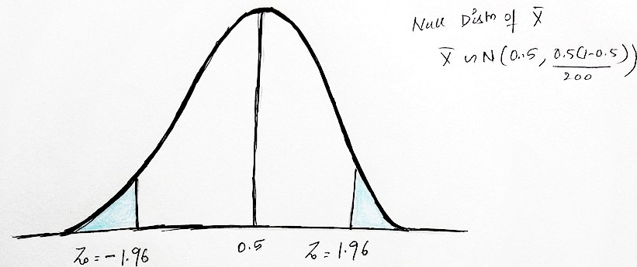
Null Distribution
0.43
0.569

Slide 214
Critical Value
Null distribution of p_hat:
p_hat ~ N(0.50, 0.50 (1 – 0.50)/200)
p_hat ~ N(0.50, 0.25/200)
Since its two-sided test, we reject H0 whenever (as α = 0.05):
Critical Value
Z ≤ -1.96
Z ≥ 1.96
p_hat ≤ -1.96 * sqrt(0.25/200) + 0.5
p_hat ≥ 1.96 * sqrt(0.25/200) + 0.5
p_hat ≤ 0.43
p_hat ≥ 0.569

Slide 215
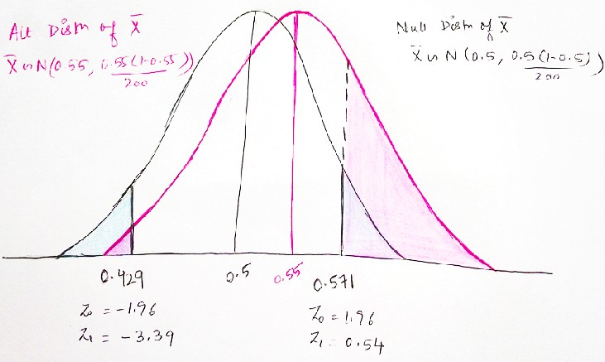
Alternate Distribution
0.43
0.569

Slide 216
Alternate Distribution
Alternate distribution of p_hat: p_hat ~ N(0.55, 0.25/200)
Computing power:
z- scores corresponding to Critical Value under the alt distribution
Z = (0.43 – 0.55) / sqrt(0.25/ 200)
Z = -3.39
Z = (0.569 – 0.55)/ sqrt(0.25/200) Z = 0.54
P(Z < -3.39) = .0003 P(Z > 0.54) = 0.2946
Power = 0.0003 + 0.2946 = 0.2949

Slide 217
Problem 5
●
A pollster will conduct a survey of a random sample of voters in a community to estimate the proportion who support a measure on school bonds.
Let p be the proportion of the population who support the measure. The pollster will test:
H 0 : p = 0.50 versus H 1 : p ≠ 0.50
at the 5% level. How many voters must be sampled so that the power will be 0.8 when the true value of p = 0.55?
●
●

Slide 218
We can generally ignore the miniscule region associated with one of the tails
Critical Value under Null Distribution
Z ≤ -1.96
Z = 1.96
p_hat ≤ -1.96 * sqrt(0.25/n) + 0.5 (Ignored)
p_hat = 1.96 * sqrt(0.25/n) + 0.5
Critical Value under Alternate Distribution
Z = (0.43 – 0.55) / sqrt(0.25/ n) Z = -3.39
Since Power = 0.80
P(Z > z) = 0.80 => z-score = -0.84
P(Z < -3.39) = .0003
(ignored)
p_hat = -0.84 * sqrt(0.25/n) + 0.55

Slide 219
Setting the critical values equal
1.96 * sqrt(0.25/n) + 0.5 = -0.84 * sqrt(0.25/n) + 0.55
=> sqrt(n) = (1.96 + 0.84) / 0.1 = 28
=> n = 784

Slide 220
Problem 6 – Part a
A tire company claims that the lifetimes of its tires average 50,000 miles. The standard deviation of tire lifetimes is known to be 5000 miles. You sample 100 tires and will test the hypothesis that the mean tire lifetime is at least 50,000 miles against the alternative that it is less. Assume, in fact, that the true mean lifetime is 49,500 miles.
a. State the null and alternate hypotheses. Which hypothesis is true?

Slide 221
Problem 6 – Part a : Solution
H0 : µ ≥ 50,000 vs. H1 : µ < 50,000
Since True mean lifetime is 49,500 miles , this implies Alternate Hypothesis is true.
●
●

Slide 222
Problem 6 – Part b
A tire company claims that the lifetimes of its tires average 50,000 miles. The standard deviation of tire lifetimes is known to be 5000 miles. You sample 100 tires and will test the hypothesis that the mean tire lifetime is at least 50,000 miles against the alternative that it is less. Assume, in fact, that the true mean lifetime is 49,500 miles.
H0 : µ ≥ 50,000 vs. H1 : µ < 50,000
b. If the test is made at the 5% level, what is the power?

Slide 223
Problem 6 – Part b : Solution
H0 : µ ≥ 50,000 vs. H1 : µ < 50,000
Null distribution of X_bar:
X_bar ~ N(50, 000 , 5000² / 100)
α = 0.05
●
●
Since its a left tailed test, z = -1.645
Critical value: -1.645 * 5000/10 + 50,000 = 49177.5
−
Alternate Distribution of X_bar:
X_bar ~ N(49,500 , 5000² / 100)
●
⁻ Z = (49177.5 – 49500)/ (5000/10) = -0.645 = -0.65
⁻ Power = P(Z < -0.65) = 0.2578.

Slide 224
Problem 6 – Part c
A tire company claims that the lifetimes of its tires average 50,000 miles. The standard deviation of tire lifetimes is known to be 5000 miles. You sample 100 tires and will test the hypothesis that the mean tire lifetime is at least 50,000 miles against the alternative that it is less. Assume, in fact, that the true mean lifetime is 49,500 miles.
c. At what level should the test be conducted so that the power is 0.80?

Slide 225
Problem 6 – Part c : Solution
Alternate Distribution of X_bar:
X_bar ~ N(49,500 , 5000² / 100) Power = 0.80 => P(Z < z ) = 0.80 => z = 0.84
Critical value:
●
●
0.84 * 5000/10 + 49500 = 49, 920
Null distribution of X_bar:
X_bar ~ N(50, 000 , 5000² / 100)
Z = (49920 – 50000)/ 500 = -0.16
Significance level = P(Z < -0.16) = 0.4364.
●
●

Slide 226
Problem 6 – Part d
A tire company claims that the lifetimes of its tires average 50,000 miles. The standard deviation of tire lifetimes is known to be 5000 miles. You sample 100 tires and will test the hypothesis that the mean tire lifetime is at least 50,000 miles against the alternative that it is less.
Assume, in fact, that the true mean lifetime is 49,500 miles.
d. It is decided to reject H 0 if the sample mean is less than or equal to 49,400. Find the level and power of this test.

Slide 227
Problem 6 – Part d : Solution
Null distribution of X_bar:
X_bar ~ N(50, 000 , 5000² / 100)
Critical value = 49,400
Z = (49400 – 50000)/500 = -1.2
Significance level = P(Z < -1.2) = 0.1151 Alternate Distribution of X_bar:
X_bar ~ N(49,500 , 5000² / 100) Z = (49400 – 49500)/500 = −0.20
Power = P(Z < -0.20) = 0.4207
●
●
●
●
●
●
●

Slide 228
Problem 6 – Part e
A tire company claims that the lifetimes of its tires average 50,000 miles. The standard deviation of tire lifetimes is known to be 5000 miles. You sample 100 tires and will test the hypothesis that the mean tire lifetime is at least 50,000 miles against the alternative that it is less. Assume, in fact, that the true mean lifetime is 49,500 miles.
e. You are given the opportunity to sample more tires. How many tires should be sampled in total so that the power is 0.80 if the test is made at the
5% level?

Slide 229
Problem 6 – Part e : Solution
H0 : µ ≥ 50,000 vs. H1 : µ < 50,000
Null distribution of X_bar:
X_bar ~ N(50, 000 , 5000² / n)
α = 0.05
●
●
Since its a left tailed test, z = -1.645
Critical value: -1.645 * 5000/sqrt( n) + 50,000
−
Alternate Distribution of X_bar:
X_bar ~ N(49,500 , 5000² / n)
●
⁻ Power = P(Z < z) = 0.80 => z = 0.84
⁻ Critical value = 0.84 * 5000/sqrt( n) + 49500
●
Setting the critical values equal:
-1.645 * 5000/sqrt( n) + 50,000 = 0.84 * 5000/sqrt(n) + 49500
=> n = 618
Prof. Preet Kanwal

Slide 230
Factors affecting Power of a test

Slide 231
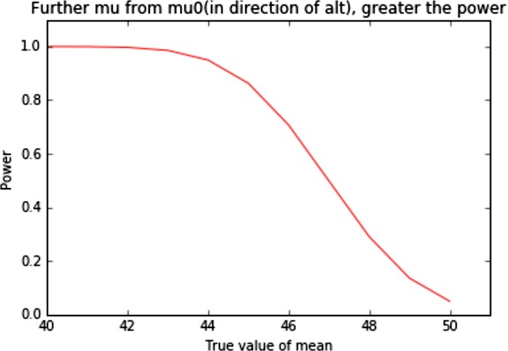
H0 : µ ≥ 50, H1: µ < 50, α = 0.05, n =30, σ = 10

Slide 232
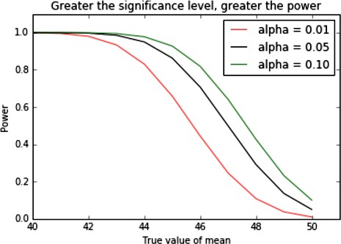
H0 : µ ≥ 50, H1: µ < 50, n =30, σ = 10

Slide 233
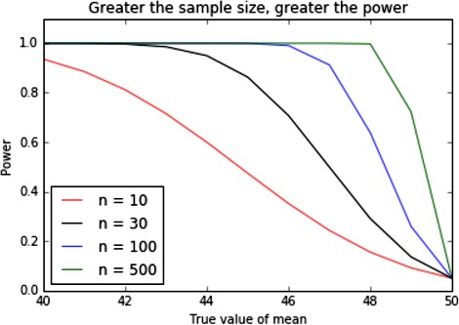
H0 : µ ≥ 50, H1: µ < 50, α = 0.05, σ = 10

Slide 234
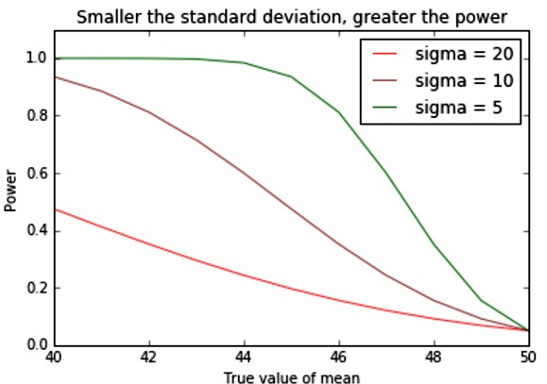
H0 : µ ≥ 50, H1: µ < 50, α = 0.05, n =30

Slide 235
Problem 7
A power calculation has shown that if µ = 8, the power of a test of H 0 : µ ≥ 10 versus H 1 : µ < 10 is 0.90. If instead µ = 7, which one of the following statements is true?
The power of the test will be less than 0.90.
The power of the test will be greater than 0.90.
We cannot determine the power of the test without knowing the population standard deviation σ .

Slide 236
Problem 7 : Solution
(ii). Since 7 is farther from the null mean of 10 than 8 is, the power against the alternative µ = 7 will be greater than the power against the alternative µ = 8.

Slide 237
Summary
Power increases as:
α increases
n Increases
σ decreases
The true value of µ gets further from µ₀(in the direction of alternative hypothesis)

Slide 238
Thank you !

